Slide 1

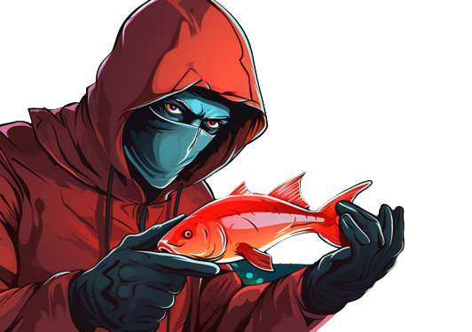
Phishing Awareness Education Training
Presented by Richard Brandon

Slide 2

Familiarize yourself with phishing attacks Teams most affected by phishing
1. Human Resources
a. 75% of the department was successfully phished during the last simulation
2. Marketing
a. 38% of the department was successfully phished during the last simulation

Slide 3

What is phishing?
Phishing is a type of cyberattack where attackers use deceptive emails or messages to trick individuals into revealing sensitive information.
Phishing is the most common and effective type of cybersecurity threats.

Slide 4

Learn to Discern
Slogan: Don’t click that link, It might stink!

Slide 5
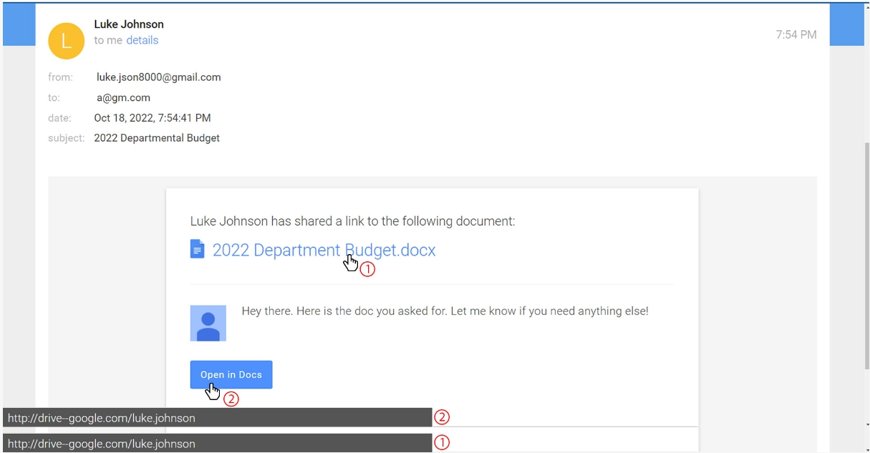
Learn to spot phishing emails
Can you see the difference?
Is this email using https? Should a department doc be opening and downloading from a employees google drive?
The answer to both questions is no.

Slide 6
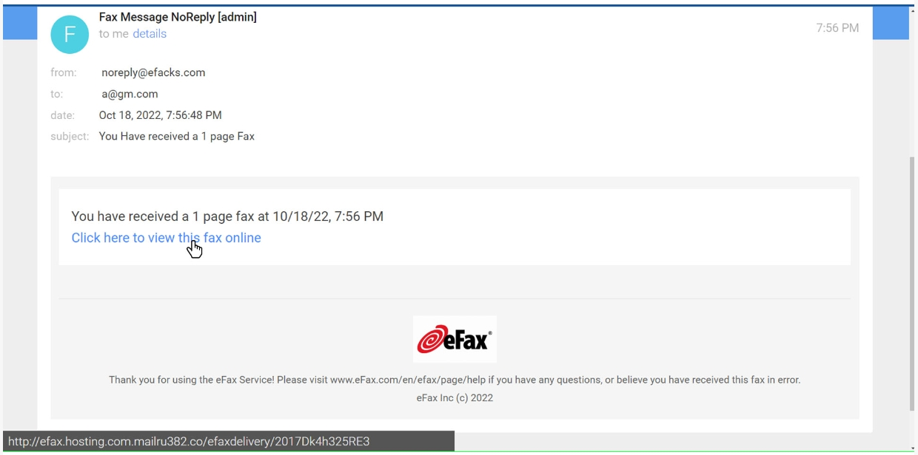
Is this email legit?
Is there any typos in this email?
Where does the link lead to on the internet when clicked?

Slide 7
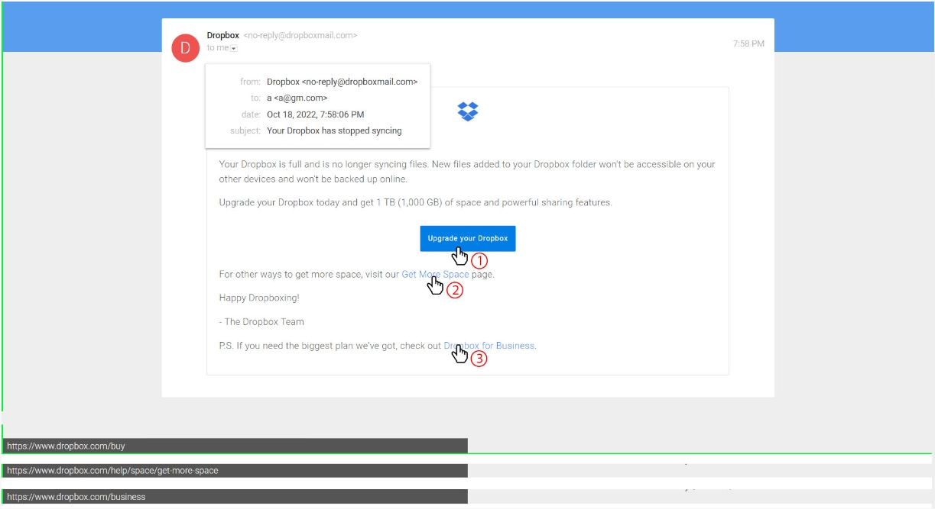
How about this one?
Is this email real or a phishing attempt?
Does it use Https? Are there any typos?
Where do the links lead to on the internet?

Slide 8

How do we defend against phishing?
Verify email senders' addresses before clicking on links or downloading attachments.
Hover over hyperlinks to see the actual URL destination.
Never share personal or sensitive information in response to an email request.
Be cautious with emails that evoke strong emotions like fear or excitement.
Report suspicious emails to IT or the security team.

Slide 9

Conclusion
Recap
Questions and Answers
Don’t click that link, it might stink!

Slide 10

Thank you for your time

